Slide 1

Sparse Identification of Nonlinear Dynamics
111061590
林學謙

Slide 2
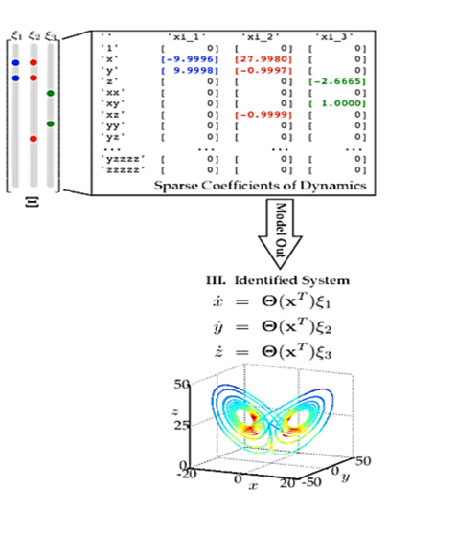
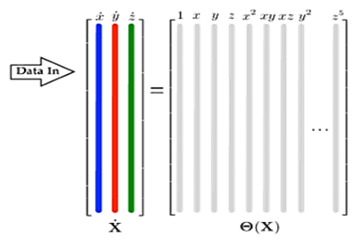
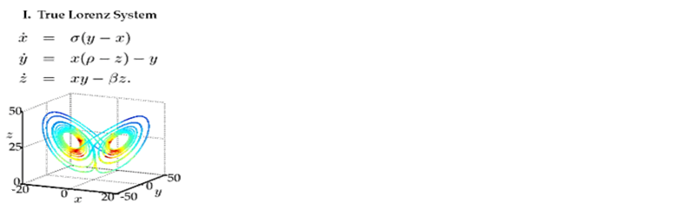
What is SINDy ?

Slide 3
In summary
Pros
It can use data to generate similar dynamic systems
Sparsity make it identify the most important features and reducing overfitting
Cons
The data matrix must conclude possible variable combination.
The data quality

